Slide 2

For loop
Note that i increment only occurs after execution

Slide 3
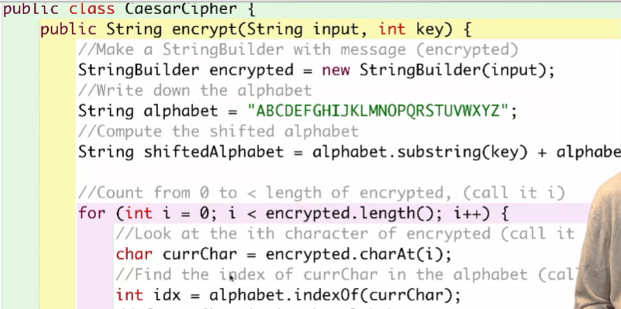

Sample code for ccaesarcipher

